Slide 1
Code Prep
Johnny Lee

Slide 2
Resume Building
Recruiters only spend a fixed amount of time (about 10 seconds) looking at your resume.
If you limit the content to the most impressive items, the recruiter is sure to see them.
Try using the approach for each accomplishment: “Accomplished X by implementing Y which led to Z”
Example:
“Reduced object rendering time by 75% by implementing distributed caching, leading to a 10% reduction in log-in time”

Slide 3

Behavioral Stories
Common Questions | Project 1 | Project 2 | Project 3
Challenges
Mistakes/Failures
Enjoyed
Leadership
Conflicts
What I’d do Differently

Slide 4
Structured Answers to Behavioral Questions
“Nugget first” – “nugget that succinctly describes what your response will be about.
Example:
Interviewer: “Tell me about a time you had to persuade a group of to make a big change”
Candidate: “Sure, let me tell you about the time when I convinced my school to let undergraduates teach their own courses. Initially, my school had a rule where….”

Slide 5
Situation, Action, Result (S.A.R.)
Situation – Outline the situation
Action - Explain the actions you took
Result – Describe the result
 | Nugget | Situation | Action(s) | Result | What it Says
Story 1 |  |  | … … …
Story 2

Slide 6
Analyze your Answers
Think about what you did says to the interview:
Initiative/Leadership
Empathy
Compassion
Humility
Teamwork/Helpfulness
Show your positive attributes clearly:
Less clear
“I called up the client and told him what happened.”
More clear
“I made sure to call the client myself, because I knew he would appreciate hearing directly from me.”

Slide 7
Interviewee Questions
Genuine Questions | Insightful Questions | Passion Questions
What is the ratio of devs to product managers? | I noticed that you use technology X. How do you handle problem Y. | I’m very interested in scalability, and I’d love to learn about it. What opportunities are there at this company to learn about this?

Slide 8
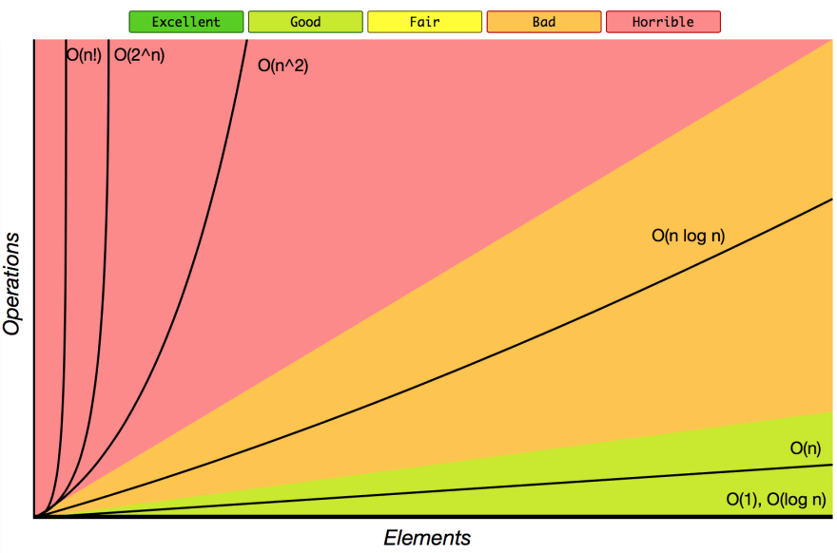

Big O
O (big O): Upper bound on time and space. Similar to <=.
$Ω$(big omega): Lower bound on time and space.
$Θ$(big theta): Tight bound on time and space. Describes both big omega and big O.

Slide 9
Problem-Solving Flowchart
Listen
Pay close attention to what the interviewer says
Example
Draw a good example for the problem
Create a brute force solution to the problem
Brute Force
Optimize the Solution
Walk through your solution
Implement
Work on optimizing your brute force solution into an optimal solution
Walk Through
Implement the solution in code
Test
Try to see the special cases for the problem
State a naïve solution and its runtime
Make sure you understand what your solution does
Try to write beautiful code
Read and analyze your code
Double check weird looking code and the lines where things could cause problems. (Ex. Base cases in recursion)
Small test cases (it’ll be faster to use small input to test your code)
Special cases (null, single element values, extreme cases, and others)

Slide 10
Techniques for Optimizing Part 1
Look for BUD:
Bottlenecks
Part of solution slowing down the overall runtime.
Unnecessary Work
Duplicated Work
Rely on Intuition
Use a nice big example. Intuitively and manually solve it then reverse engineer that intuition into an implementation
Simplify and Generalize
Simplify the constraints (Ex. Strings into characters) and solve this simplified version
Generalize the simplified solution into the more complex version

Slide 11
Techniques for Optimizing Part 2
Base Case and Build
Solve the problem first for a base case (e.g. n =1)
Try to build up from there (e.g. n = 3, n =4)
Although, this often leads to recursive solutions
Data Structure Brainstorm
Hacky, but often works
Run through a list of data structure and apply each one to see if I works

Slide 12
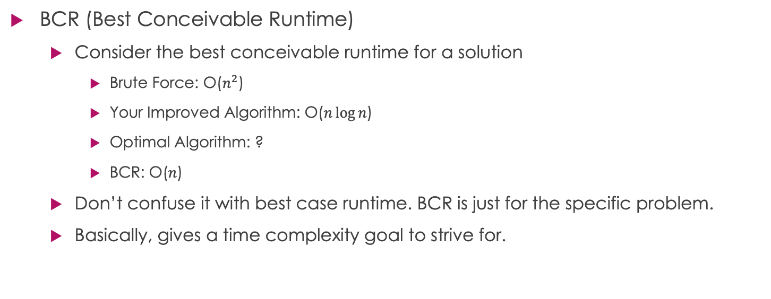
Techniques for Optimizing Part 3
BCR (Best Conceivable Runtime)
Consider the best conceivable runtime for a solution
Brute Force: O($n^{2}$)
Your Improved Algorithm: O($n\log{n}$)
Optimal Algorithm: ?
BCR: O($n$)
Don’t confuse it with best case runtime. BCR is just for the specific problem.
Basically, gives a time complexity goal to strive for.

Slide 13
Techniques for Optimizing Tips
After optimizing runtime, try to optimize space complexity.
You can apply many of the same techniques for both time and space complexity
These techniques are not mutually exclusive
Combine them or not for whatever fits your preference and the problem

Slide 14
General Coding Tips
There is a range of factors in interviews, never the correct or incorrect answer to a problem.
Don’t focus on getting the correct answer but showing your process of problem-solving and knowledge.
Admit that you’ve seen the problem before if you have.
Try to pick a programming language that you’re familiar with and is widely used.
Use data structures generously. Try creating your own if there isn’t an optimal data structure.
Appropriate code reuse. Leverage code reuse and try not to repeat yourself in code.
Write modular code. Separate chunks of code that can be separated into their own methods, classes, etc.
Write flexible and robust code. Don’t hard-code.
Try to write the solution in a way that can solve a more general problem
Don’t make assumption about errors. Error check in your code when you can.
DON’T GIVE UP! Show excitement about solving hard problems.

Slide 15
Good Coding Tips
Try to write good code always.
Good code should have properties:
Correctness: Code should operate on all expected and unexpected inputs
Efficiency: Code should operate as efficiently as possible in terms of time and space
Simplicity: If code can be written in 10 lines instead of 100 lines, then do it that way.
Readability: Different developers can read your code and understand it.
Comment where necessary but implement in a way that’s easily understood.
Maintainability: Code should be reasonably adaptable

Slide 16
Handling Offers and Rejections
Don’t be afraid to ask for an extension to the deadline
If declining, decline on good terms and keep a line of communication open. You may want to work for them in the future.
If you get rejected, ask for feedback and when can you reapply if possible
Getting rejected is not the end of the world. Lots of great engineers get rejected. Doesn’t mean you’re not a great engineer.

Slide 17
Financial Package
Signing bonus, relocation, and other one-time perks
Amortize the cash over your expected time at the company
Cost of living differences
Consider the taxes, rent, and other expenses for the area the company is in
Annual bonus
Recruiter might reveal the bonus and you can check with friends at the company
Stock options and grants
Can be a big part of compensation.
Amortize it over your expected time there like a signing bonus

Slide 18
Career Development of an Offer
Ask the questions to yourself:
How good does the company’s name look on my resume?
How much will I learn? Will I learn relevant things?
What is the promotion plan? How do the careers of developers progress?
If I want to move into management, does this company offer a realistic plan?
Is the company of team growing?
If I do want to leave the company, is it situated near other companies I’m interested in, or will I need to move?

Slide 19
Happiness Factor of an Offer
Happiness is often overlooked when considering offers but consider yourself in the position and company
Think about the stability of the position and company. Is it possible to get fired or laid off? Do you prefer start-ups or big companies?
Do you like the product? Would you be happy building it?
Do you like the management and teammates? Did you enjoy talking to the interviewers?
Company is tied to how decisions are made, social atmosphere, to the company organization. Ask the interviewers and friends what the cultures is like.
Ask how much the potential teammates typically works. See if I meshes well with your lifestyle. Remember that there are deadlines and you may work longer hours just before deadlines.

Slide 20
Offer Negotiation
Just negotiate. There’s no harm.
Recruiters almost always don’t revoke offers because of negotiation
Use viable alternatives to the offer. Use them to gain leverage because the recruiter wants you in the company.
Have a specific goal in mind for compensation. Don’t just ask for “more.”
Overshoot your goals, because it’ll be back and forth on negotiations
You can negotiate non-salary compensation too. They may not want to pay you more than your peers but signing bonuses and etc. can be possibly increased.

